Slide 1
A Novel Method for Handwritten Digit Recognition
Project Mentor :
Mr. Kumaran, B.Tech,M.E
Team Id:PNT2022TMID03585
Team Members:
Jerin Joel J
Augustine E
Arjun Dinesh S
Srivignesh R
Department of Electronics & Communication Engineering
Saveetha Engineering College

Slide 2
Contents
Problem definition
Survey Papers
Existing Application
Hardware & Software Requirements
Objective
Department of Electronics & Communication Engineering
Saveetha Engineering College

Slide 3
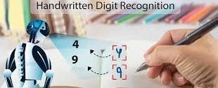
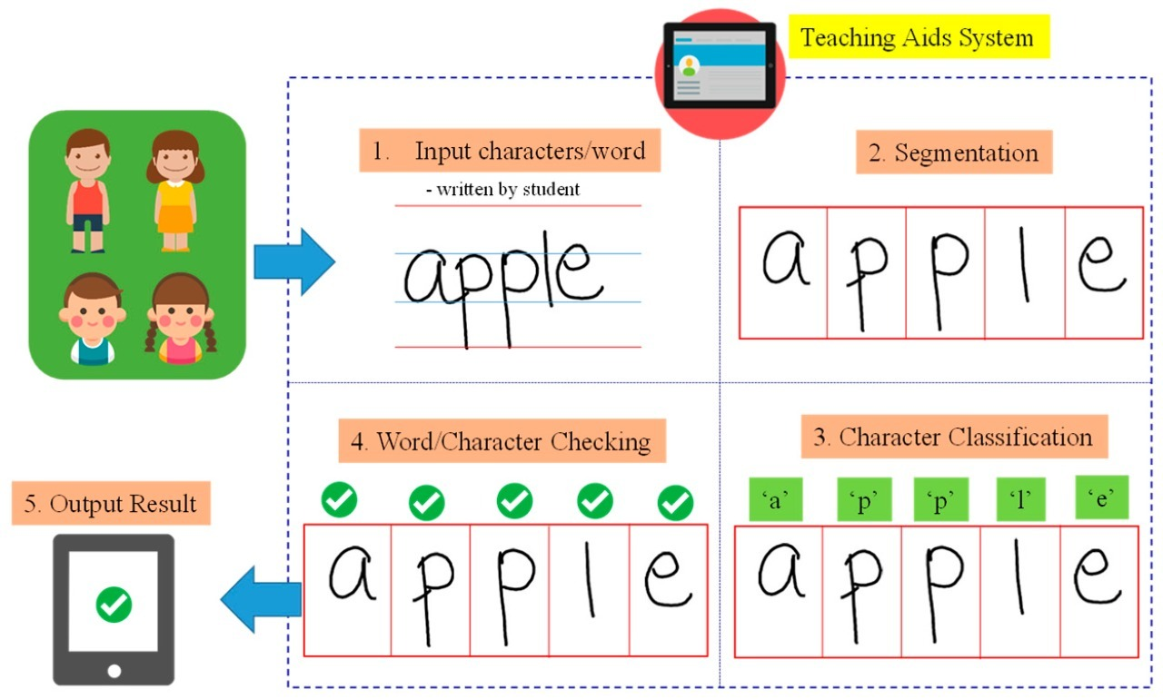
Problem definition
Handwritten character recognition (HCR) is the process of conversion of handwritten text into machine readable form. The major problem in HCR system is the variation of the handwriting styles, which can be completely different for different writers.
The objective of handwritten character recognition system is to implement user friendly computer assisted character representation that will allow successful extraction of characters from handwritten documents and to digitalize and translate the handwritten text into machine readable text.
Department of Electronics & Communication Engineering
Saveetha Engineering College

Slide 4
Problem definition
Architecture of the Application
1. Image Acquisition: The input image is sent to the recognition system during the image acquisition stage. The input can be in the form of an image(JPEG, PNG, etc. ), a scanned picture, a digital camera, or any other acceptable digital input device.
2. Data Augmentation: The dataset is divided into two parts where 80% is used for training and 20% is used for testing. To boost the efficiency of the model, the diversity in the data is artificially boosted using Data Augmentation. By rotating the images of the dataset to form images with different angles.
3. Splitting of dataset: The dataset is splitted into two parts that are testing and training. 80% of the dataset is used for training and 20% for testing.
4. Preprocessing: Pre-processing is the first step in character recognition and is crucial in determining the recognition rate. Preprocessing helps to normalise the strokes and remove any variations that could slow down the accuracy rate. The major focus of preprocessing is on numerous distortions such as irregular text size, points lost during pen movement, jitters, left-right bend, and uneven spacing. Noise reduction, binarization, and normalizing are all part of the process.
Department of Electronics & Communication Engineering
Saveetha Engineering College

Slide 5
Problem definition
Architecture of the Application
6.Segmentation: Segmentation is a technique for breaking down a large input image into individual characters. Word, line, and character segmentation are the approaches employed. It's usually done by separating single characters from a word graphic.
7. Feature Extraction: Deep learning itself extracts features with deep neural networks and classifies itself. Compared to traditional algorithms its performance increases with increase in dataset.
8. Classification: CNN is used to classify the image based on its features and along with the trained dataset. The Handwritten Character Recognition recognizes an image when it is given as an input, its important features are extracted and is provided as an input to the CNN classifier. It compares the featured image with the trained dataset and classifies the image with higher accuracy.
9. Taking real time user input: Now the model is used to recognise real time characters written by the user. Users need to write on paper and upload the scanned copy of the same to predict the text written by them.
10. Output: The output specifying what was written in the input image is obtained.
Department of Electronics & Communication Engineering
Saveetha Engineering College

Slide 6
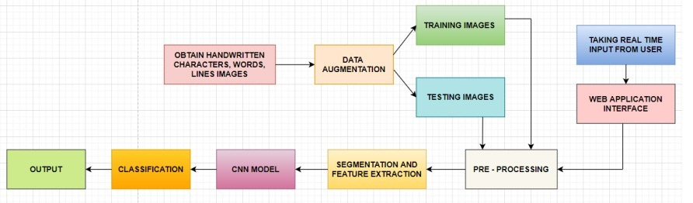
Problem definition
Architecture of the Application
Department of Electronics & Communication Engineering
Saveetha Engineering College

Slide 7
Survey Papers
Author Name : Gaurav Surve
Title : Handwritten Character Recognition
Publication website : https://www.ijcrt.org/
Published Date : April 4, 2022
Objective : Handwritten digit recognition has a wide range of applications, including identifying postal codes on envelopes, processing largescale financial statements, and processing bank form input. It was often thought that people who used computers for business had to change their input style to match what the computer expected, whether they were typing or filling out forms with letters.
Technology used: Tensor flow - Tensor flow is the core open source library to help you develop and train Machine Learning models.
Department of Electronics & Communication Engineering
Saveetha Engineering College

Slide 8
Existing Application
Developed by : Globid
Title : Handwriting Recognizer
Publication website : https://play.google.com/store/apps/details?id=handwriting.to.text.convert
Published Date : 2022
Objective : This handwritten text recognition app “Handwriting Recognizer” can be both used for your personal and professional use. Just scribble the notes and later get them converted to digital text instantly. The app is very easy to use and is designed with an intuitive user interface. Get your own pocket-friendly hand recognizer app and reduce your effort to manually convert your notes into digital text.
Department of Electronics & Communication Engineering
Saveetha Engineering College

Slide 9
Existing Application
Developed by : Appsuit
Title : Handwriting to Text Converter
Publication website : https://play.google.com/store/apps/details?id=com.appsuite.handwriting.to.text
Published Date : June 14, 2022
Objective : Use the simple, yet accurate Handwriting to Text Converter app. Our OCR handwriting to text converter comes with an inbuilt scanner that quickly analyzes your handwriting and turns it into usable text.
Department of Electronics & Communication Engineering
Saveetha Engineering College

Slide 10
De-Merits:
Since the computers have evolved, lot of research has been carried in the area of Computer and Human interface. In this Era of advanced technology, there is greater need for conversion of analog into digital.
With the advent of digital scanners and after the computer came into the scene, we have witnessed huge demand to convert books and text into digital media, viewable over the internet and on a computer .
It is a complex task to input data characters for scripts like Devanagari and Gurmukhi because they have a complex writing style. So the best possible methods to input such characters are via Hand-written documents and Speech.
Speech Recognition has some disadvantages. So the main focus of this research is Recognition of Handwritten Characters. This is where Handwritten Character Recognition comes in handy. Handwritten Character Recognition.
Department of Electronics & Communication Engineering
Saveetha Engineering College

Slide 11
Hardware Requirements:
● Processor : Intel Core i5
● HDD: 1TB
● RAM: Minimum 2GB; Recommended 4GB
Software Requirements:
● Operating system : Windows 10
● Dataset: IAM Dataset(Words, Lines)
● Programming Language: Python
● Numpy : Core package providing powerful tools to manipulate data arrays, such as our character images.
● OpenCV : OpenCV is a large open-source library for image processing, character recognition, and machine learning. It canscan handwritten images.
● Autocorrect : It is used to correct the spelling. It supports many languages.
● Tensorflow : Tensorflow is the core open source library to help you develop and train Machine Learning models.
Department of Electronics & Communication Engineering
Saveetha Engineering College

Slide 12
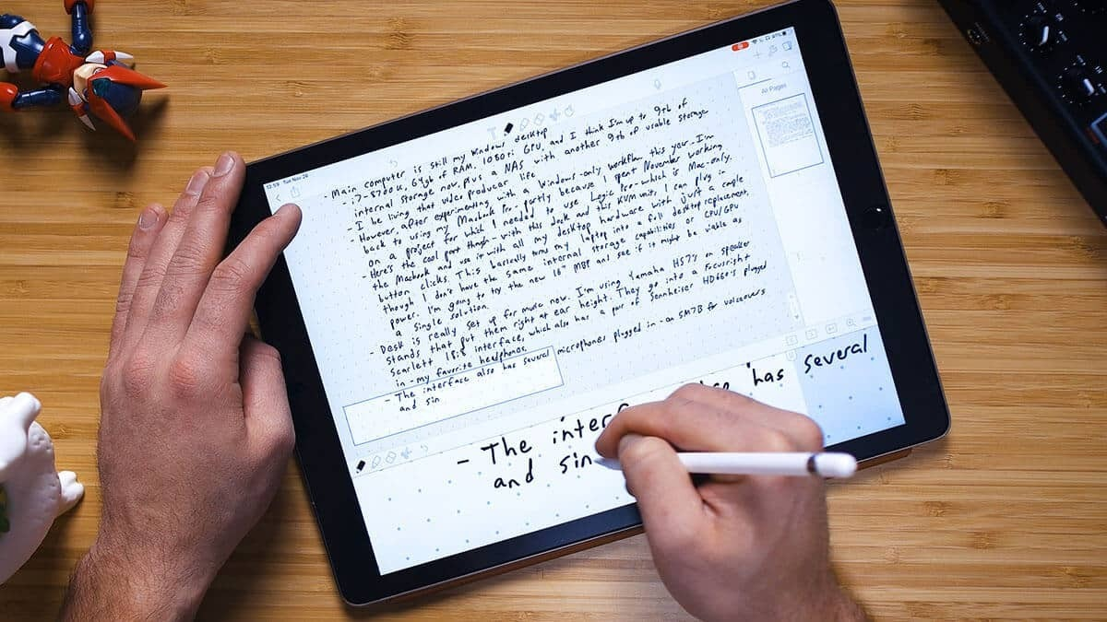
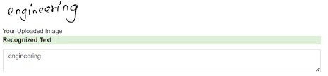
Objective:
Handwriting recognition has gained a lot of attention in the field of pattern recognition and machine learning due to its application in various fields.
Optical Character Recognition(OCR) and Handwritten Character Recognition (HCR) has specific domain to apply. Various techniques have been proposed to for character recognition in handwriting recognition system.
Even though, sufficient studies and papers describes the techniques for converting textual content from a paper document into machine readable form.
In coming days, character recognition system might serve as a key factor to create a paperless environment by digitizing and processing existing paper documents. This paper presents a detailed review in the field of Handwritten Character Recognition
Department of Electronics & Communication Engineering
Saveetha Engineering College

Slide 13
THANK YOU
Department of Electronics & Communication Engineering
Saveetha Engineering College

